Slide 1
Intro to Civic Hacking
Nate Benes (@prefork)

Slide 2
I’m going to make you do stuff
did you bring a laptop?

Slide 3
http://bit.ly/civichacktalk

Slide 4
http://bit.ly/civichacktalk
Go here now

Slide 5
http://bit.ly/civichacktalk
Download the .zip
Sign up for CartoDB

Slide 6
http://bit.ly/civichacktalk
Keep this link handy

Slide 7
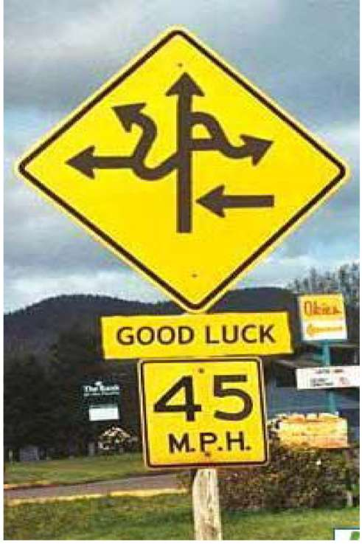
Where are we going?
What is civic hacking?
Why would I want to do it?
How do I get started?
Make stuff.
http://www.john3thirty.net/wp-content/uploads/2014/04/confusing-road-sign.jpg

Slide 8
Hacker

Slide 9

http://www.chiangraitimes.com/wp-content/uploads/2014/05/Computer-hacker.jpg

Slide 10

http://asicscrypt.com/wp-content/uploads/2014/07/hacker.jpg

Slide 11

http://www.digitaltrends.com/wp-content/uploads/2013/12/hacker.jpg

Slide 12
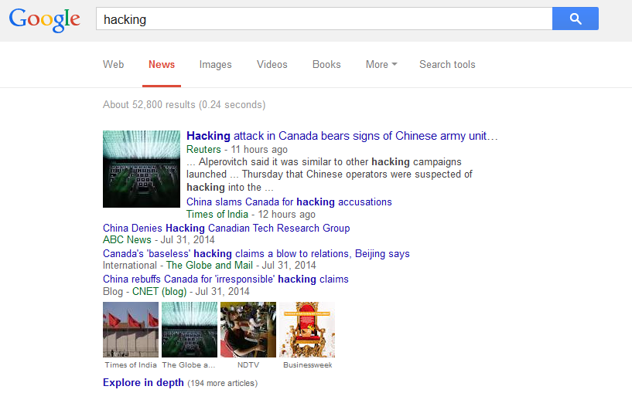
http://www.digitaltrends.com/wp-content/uploads/2013/12/hacker.jpg

Slide 13
Hacker

Slide 14
Hacker
Not what you think it means

Slide 15
Civic Hackers

Slide 16

Civic Hackers

Slide 17
“…people working together quickly and creatively to make their cities better for everyone…”
codeforamerica.org

Slide 18
Civic Hackers
Programmers

Slide 19
Civic Hackers
Programmers, librarians, analysts

Slide 20
Civic Hackers
Programmers, librarians, analysts, farmers, artists, policy makers, carpenters, students, teachers, clerks, engineers…

Slide 21
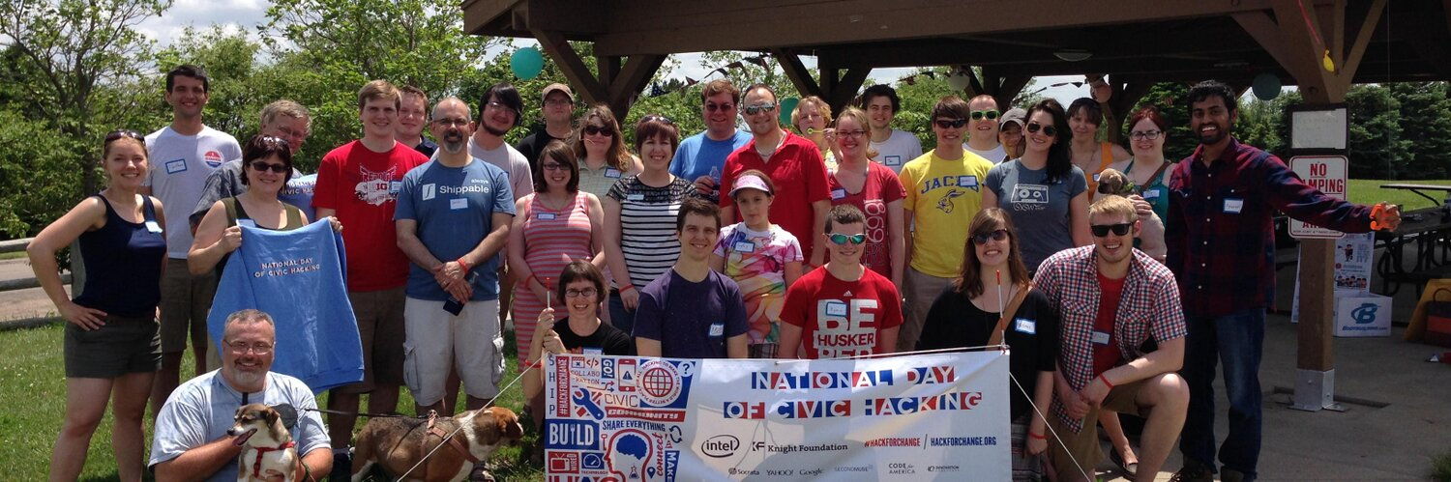

Slide 22
Why not you?

Slide 23




Slide 24


Slide 25
Where are we going?
What is civic hacking?
Why would I want to do it?
How do I get started?
http://www.john3thirty.net/wp-content/uploads/2014/04/confusing-road-sign.jpg

Slide 26
Civic apps

Slide 27
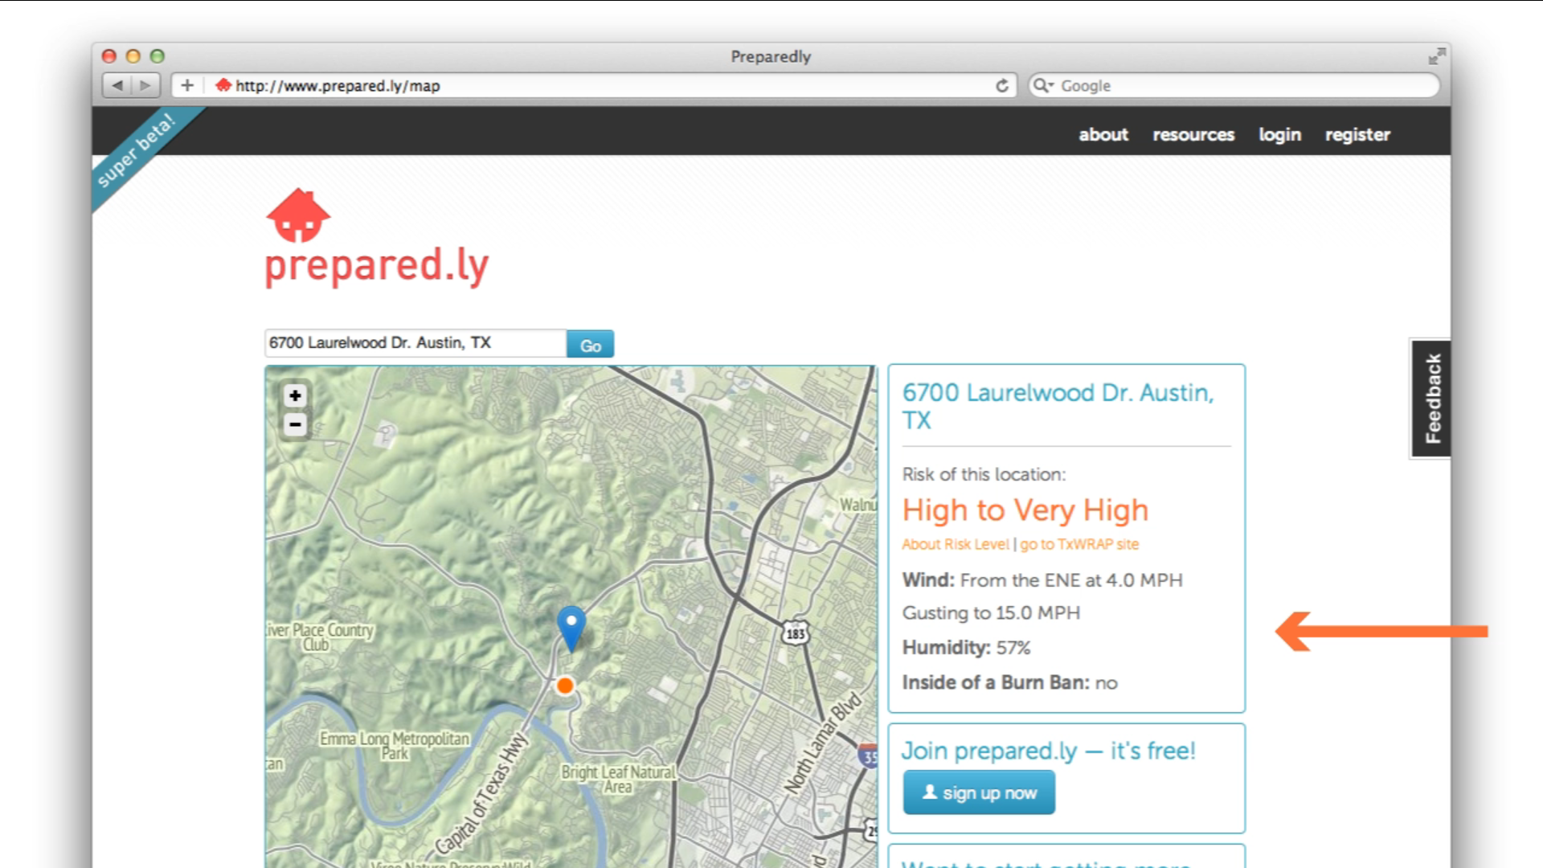

Slide 28
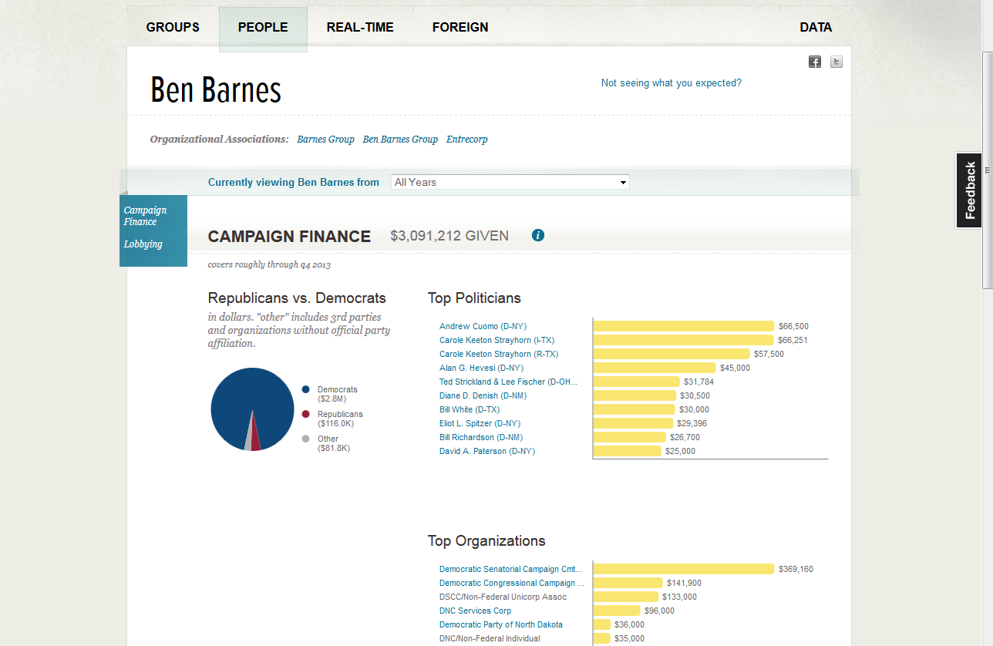

Slide 29
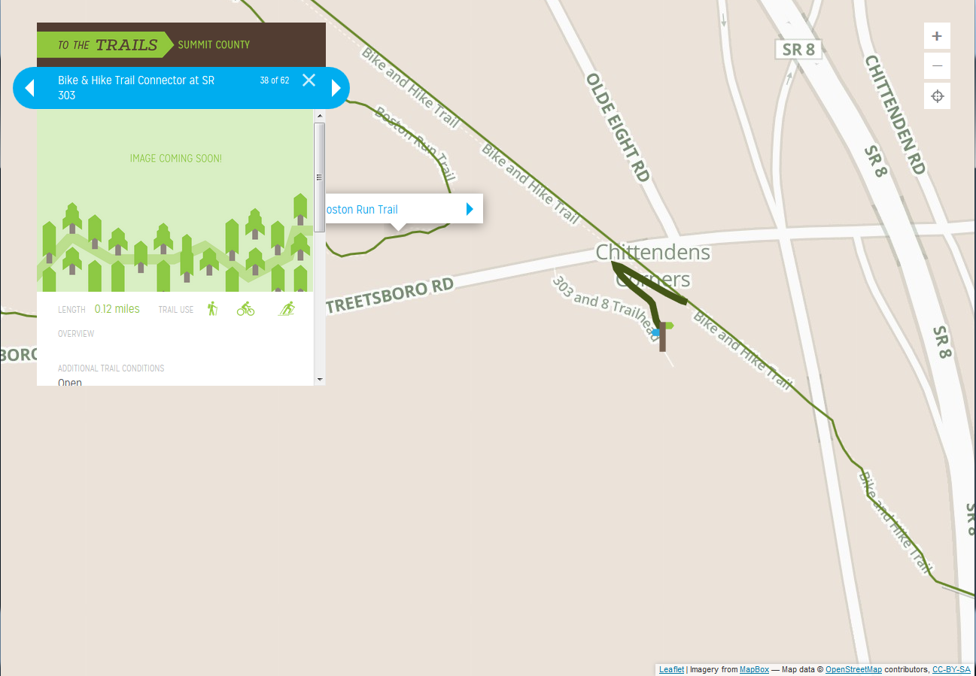

Slide 30
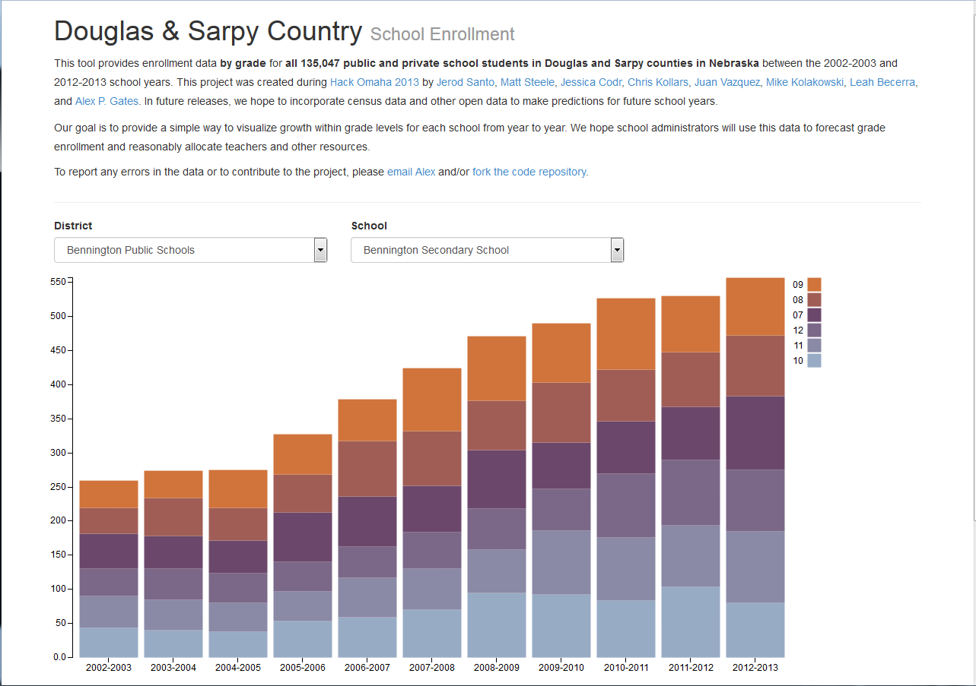

Slide 31
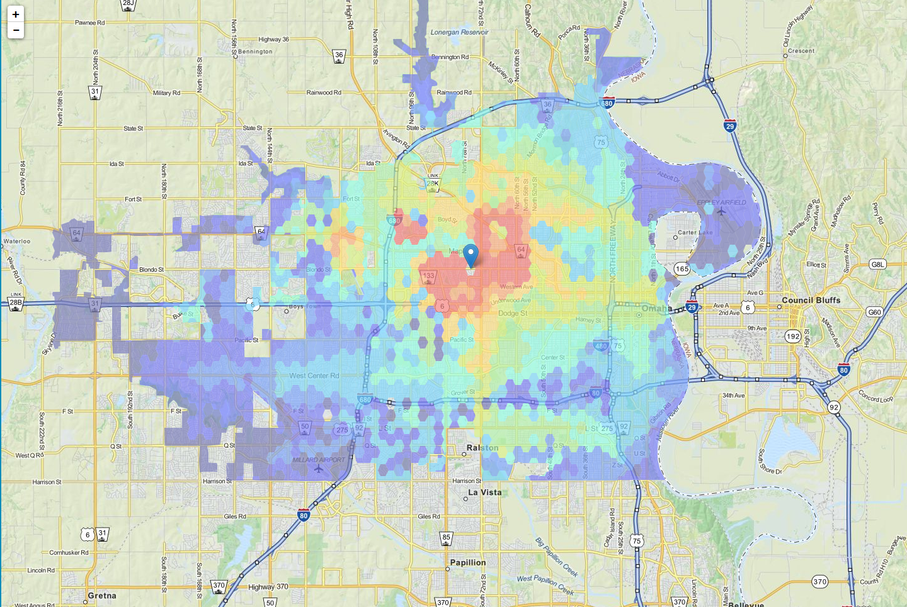

Slide 32
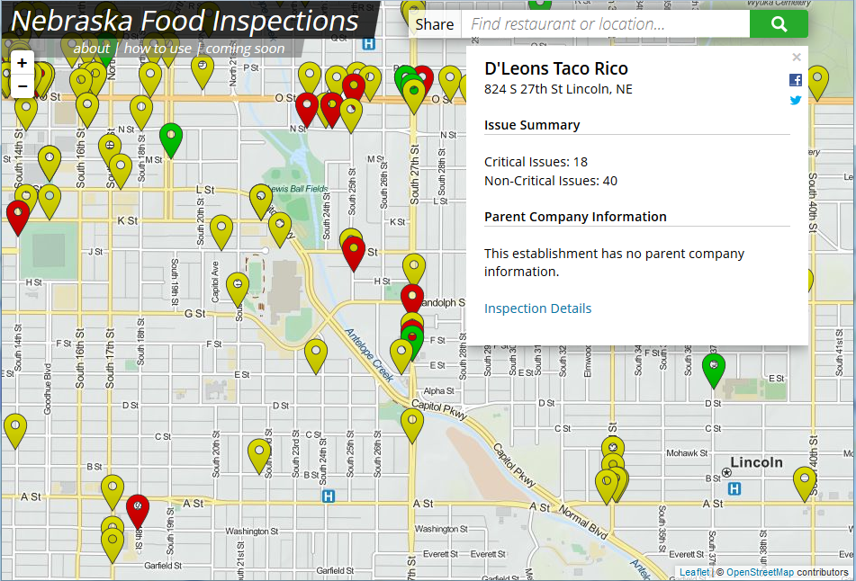

Slide 33
Where are we going?
What is civic hacking?
Why would I want to do it?
How do I get started?
http://www.john3thirty.net/wp-content/uploads/2014/04/confusing-road-sign.jpg

Slide 34
Where are we going?
What is civic hacking?
Why would I want to do it?
How do I get started?
Prerequisites
http://www.john3thirty.net/wp-content/uploads/2014/04/confusing-road-sign.jpg

Slide 35


Slide 36
Public records

Slide 37
5 U.S.C. § 552

Slide 38
Freedom of Information Act
(FOIA)

Slide 39
FOIA
Enacted in 1966
Must submit in writing (email ok)
Media and academia exempt from fees, others can file waiver (need to prove request is in public interest)
Some exceptions (HR, National Security, Oil and Gas…)
Response within 20 days
Full text here: http://www.justice.gov/oip/foia_updates/Vol_XVII_4/page2.htm

Slide 40
FOIA Request
This is a request under the Freedom of Information Act. I hereby request the following records...

Slide 41
FOIA Request
This is a request under the Freedom of Information Act. I hereby request the following records...
I also request that, if appropriate, fees be waived as I believe this request is in the public interest. The requested documents will be used for...

Slide 42
FOIA Request
This is a request under the Freedom of Information Act. I hereby request the following records...
I also request that, if appropriate, fees be waived as I believe this request is in the public interest. The requested documents will be used for...
In the event that fees cannot be waived, I would be grateful if you would inform me of the total charges in advance of fulfilling my request.

Slide 43


Slide 44
FOIA Request
This is a request under the Freedom of Information Act. I hereby request the following records...
I also request that, if appropriate, fees be waived as I believe this request is in the public interest. The requested documents will be used for...
In the event that fees cannot be waived, I would be grateful if you would inform me of the total charges in advance of fulfilling my request.
I would prefer the request filled electronically, by e-mail attachment if available or CD-ROM if not.

Slide 45


Slide 46
Neb. Rev. Stat. §§ 84-712

Slide 47
Nebraska Public Records Law

Slide 48
Nebraska Public Records Law
Enacted in 1961 (!)
Not the same as FOIA
Must submit in writing (email ok)
Only obligated to provide data in “original form”.
Free to examine records in person, may charge to recoup the cost of copies, media, labor.
Response within 4 days (!)
Full text here: http://uniweb.legislature.ne.gov/laws/statutes.php?statute=84-712

Slide 49
Nebraska Public Records Request
This is a request under the Nebraska Public Records Law. I hereby request the following records...
I also request that, if appropriate, fees be waived as I believe this request is in the public interest. The requested documents will be used for...
In the event that fees cannot be waived, I would be grateful if you would inform me of the total charges in advance of fulfilling my request.
I would prefer the request filled electronically, by e-mail attachment if available or CD-ROM if not.

Slide 50
Need help?

Slide 51
Other resources
Nebraska Secretary of State’s office
Your City/County Clerk’s office
Your local library

Slide 53
Scraping data

Slide 54
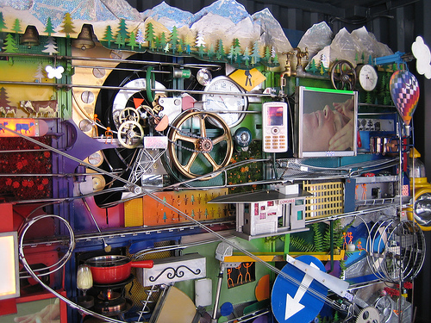
http://www.radicalsocialentreps.org/wp-content/uploads/2012/04/rube-goldberg.jpg

Slide 55
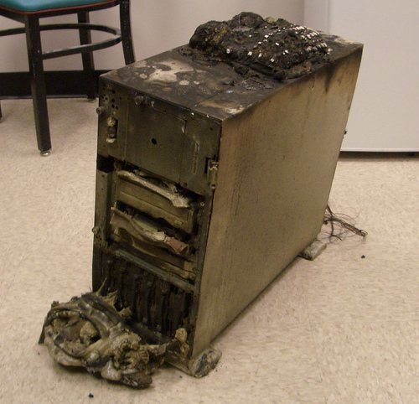
http://interweb.files.wordpress.com/2006/08/19.jpg

Slide 56


Slide 57
Other resources
ScraperWiki

Slide 58
Open access \neq Open data

Slide 59


Slide 61
Where are we going?
What is civic hacking?
Why would I want to do it?
How do I get started?
Prerequisites
Find a problem to solve
http://www.john3thirty.net/wp-content/uploads/2014/04/confusing-road-sign.jpg

Slide 62
Problem
#1

Slide 63
How do I pick the most effective senator in the Nebraska Legislature?

Slide 64
Audience Participation

Slide 65
That wasn’t fun

Slide 66
How do you feel about PDFs?

Slide 67
How do I pick the most effective senator in the Nebraska Legislature?
Take #2

Slide 68
Audience Participation

Slide 69
That was way easier

Slide 70
That was way easier
Hypothesis: Tabular data is much nicer to work with

Slide 71
What else could you learn from this information?

Slide 72
Problem
#3

Slide 73
When is Facebook coming to Nebraska?

Slide 74
Audience Participation

Slide 75
Was that easier?

Slide 76
Was that easier?
Revised hypothesis: simple data is nicer to work with

Slide 77
Simpleopendata.com

Slide 78
Problem
#4

Slide 79
Where can I park my car?

Slide 80
Audience Participation

Slide 81
Geodata can be fun

Slide 82
Gotchas

Slide 83
Projections

Slide 84
Projections
a.k.a. WHO PUT THE E-CREAMERY BUILDING IN AFRICA?

Slide 85
Projections
WGS-84 or go home
(also called SRID:4326)

Slide 86


Slide 87
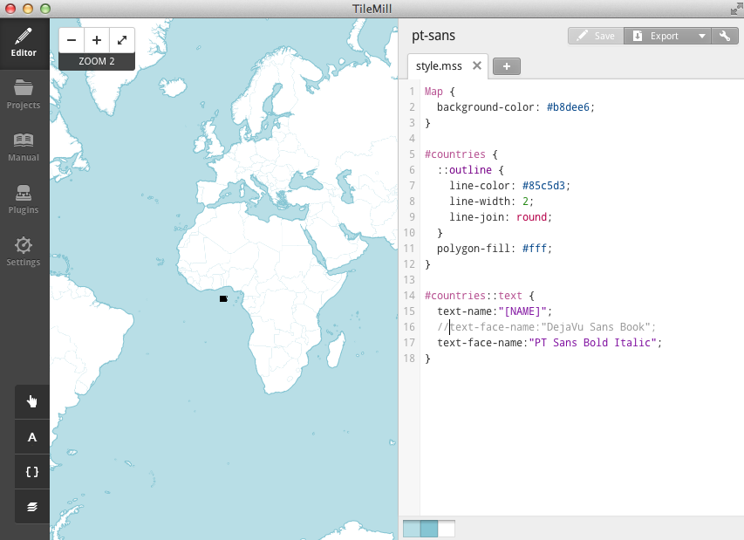

Slide 88
Questions
Nate Benes (@prefork)
team@opennebraska.io

Slide 89
Challenges

Slide 90
Where are we going?
What is civic hacking?
Why would I want to do it?
How do I get started?
http://www.john3thirty.net/wp-content/uploads/2014/04/confusing-road-sign.jpg

Slide 91
Get Involved

Slide 92

Questions?
@prefork
opennebraska.io
team@opennebraska.io

